Slide 1
User Interface Design
Main issues:
• What is the user interface
• How to design a user interface
©2008 John Wiley & Sons Ltd.
www.wileyeurope.com/college/van vliet
Notes:
© SE;User Interface Design, Hans van Vliet

Slide 2

Where is the user interface?
Seeheim model: separate presentation and dialog from application
More recently: MVC – Model-View-Controller
©2008 John Wiley & Sons Ltd.
www.wileyeurope.com/college/van vliet
Notes:
© SE;User Interface Design, Hans van Vliet

Slide 3
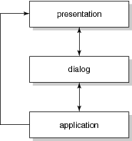
Seeheim model
©2008 John Wiley & Sons Ltd.
www.wileyeurope.com/college/van vliet

Slide 4
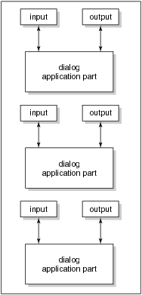
Model-View-Controller (MVC)
©2008 John Wiley & Sons Ltd.
www.wileyeurope.com/college/van vliet

Slide 5
What is the user interface?
User interface: all aspects of a system that are relevant to the user
Also called: User Virtual Machine (UVM)
A system can have more than one UVM, one for each set of tasks or roles
An individual may also have more than one user interface to the same application, e.g. on a mobile phone and a laptop
©2008 John Wiley & Sons Ltd.
www.wileyeurope.com/college/van vliet

Slide 6

Two ways to look at a user interface
Design aspect: how to design everything relevant to the user?
Human aspect: what does the user need to understand?
©2008 John Wiley & Sons Ltd.
www.wileyeurope.com/college/van vliet

Slide 7
Human factors
Humanities
  Psychology: how does one perceive, learn, remember, …
  Organization and culture: how do people work together, …
Artistic design
  Graphical arts: how doe shapes, color, etc affect the viewer
  Cinematography: which movements induce certain reactions
  Getting attractive solutions
Ergonomics
  Relation between human characteristics and artifacts
  Especially cognitive ergonomics
©2008 John Wiley & Sons Ltd.
www.wileyeurope.com/college/van vliet

Slide 8

Models in HCI
Internal models (‘models for execution’)
  Mental model (model of a system held by a user)
  User model (model of user held by a system)
External models (‘for communication’)
  Model of human information processing
  Conceptual models (such as Task Action Grammar)
©2008 John Wiley & Sons Ltd.
www.wileyeurope.com/college/van vliet

Slide 9
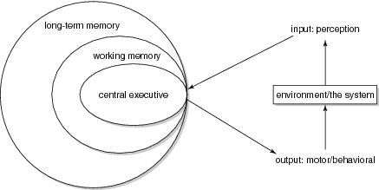
Model of human information processing
©2008 John Wiley & Sons Ltd.
www.wileyeurope.com/college/van vliet

Slide 10
Use of mental models
Planning the use of technology
  First search by author name
Finetuning user actions while executing a task
  Refine search in case of too many hits
Evaluate results
  Keep the titles on software engineering
Cope with events while using the system
  Accept slow response time in the morning
©2008 John Wiley & Sons Ltd.
www.wileyeurope.com/college/van vliet

Slide 11
Characteristics of mental models (Norman)
They are incomplete
They can only partly be ‘run’
They are unstable
They have vague boundaries
They are parsimonious
They have characteristics of superstition
©2008 John Wiley & Sons Ltd.
www.wileyeurope.com/college/van vliet

Slide 12
Conceptual model
All that is modeled as far as it is relevant to the user
Formal models
  Some model the user’s knowledge (competence model)
  Others focus on the interaction process
  Others do both
©2008 John Wiley & Sons Ltd.
www.wileyeurope.com/college/van vliet

Slide 13
Viewpoints of conceptual models
Psychological view: definition of all the user should know and understand about the system
Linguistic view: definition of the dialog between the user and the system
Design view: all that needs to be decided upon from the point of view of user interface design
©2008 John Wiley & Sons Ltd.
www.wileyeurope.com/college/van vliet

Slide 14
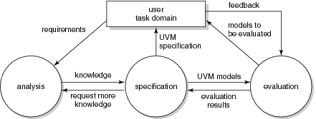
Design of the user interface
©2008 John Wiley & Sons Ltd.
www.wileyeurope.com/college/van vliet

Slide 15
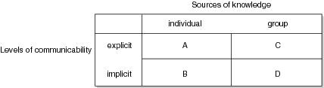
Dimensions of task knowledge
©2008 John Wiley & Sons Ltd.
www.wileyeurope.com/college/van vliet

Slide 16
Gathering task knowledge (cnt’d)
Cell A (individual, explicit): interviews, questionnaires, etc
Cell B (individual, implicit): observations, interpretation of mental representations
Cell C (group, explicit): study artifacts: documents, archives, etc
Cell D (group, implicit): ethnography
©2008 John Wiley & Sons Ltd.
www.wileyeurope.com/college/van vliet

Slide 17
Guidelines for user interface design
Use a simple and natural dialog
Speak the user’s language
Minimize memory load
Be consistent
Provide feedback
Provide clearly marked exits
Provide shortcut
Give good error messages
©2008 John Wiley & Sons Ltd.
www.wileyeurope.com/college/van vliet

Slide 18
Summary
Central issue: tune user’s mental model (model in memory) with the conceptual model (model created by designers)
User interface design requires input from different disciplines: cognitive psychology, ethnography, arts, …
©2008 John Wiley & Sons Ltd.
www.wileyeurope.com/college/van vliet

